Slide 1
Data sources and indicators to study science & innovation I
Introductory Data Science for Innovation (995N1)
Week 5
David Eggleton
With thanks to:
Frédérique Bone, Ludo Waltman, Rodrigo Costas

Slide 2
Agenda and Learning Objectives
Let’s focus on the main sources:
Science
The use of scientific publications to study Science.
Technology and Innovation
The use of patents to study technology as artefacts.
By the end of today you will be able to understand and apply:
Science
How scientific publications can be used to study Science.
Technology and Innovation
How patents can be used to study technology as artefacts.
As well as the pros and cons of such approaches

Slide 3
Lecture objectives
Data to study science and innovation:
After having acquired knowledge about how to manipulate and clean data to obtain a tidy dataset; and also introduced you to a wide range of data.
Today we are going to focus on specific data to study science and innovation. These have been traditionally used in innovation studies.

Slide 4
What data sources have been used?

Slide 5
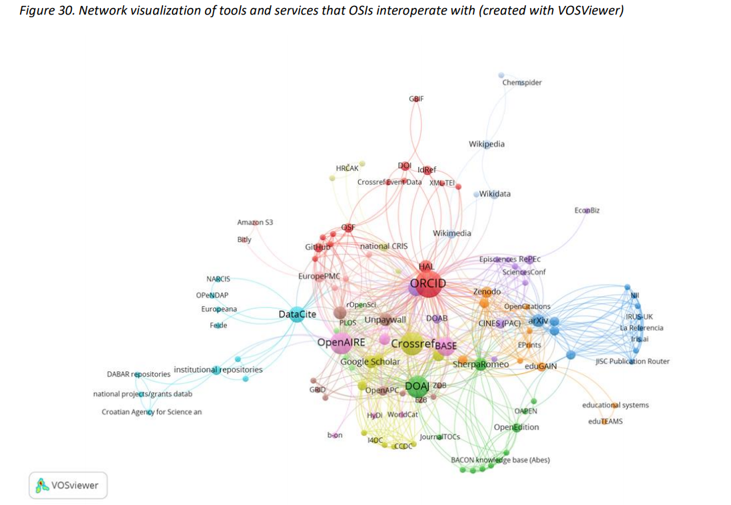

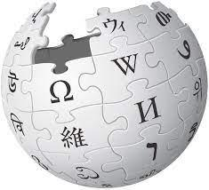









A much larger landscape of open data sources!
Ficarra, Victoria, Fosci, Mattia, Chiarelli, Andrea, Kramer, Bianca, & Proudman, Vanessa. (2020). Scoping the Open Science Infrastructure Landscape in Europe. Zenodo. https://doi.org/10.5281/zenodo.4153809

Slide 6
Data sources
Understanding dynamics in science and technology
Publications and patents
Structured data
Covering 30-50 years
Focus on
Scientific knowledge
Technological artefacts
Technometrics
Measuring technological level / quality of products.
Social media
How science and technologies feature in social medias.
Social Media
Change
Technical
Social
Publications
Patents
Technometrics
Short
Long
Period
Structured
Unstructured
Notes:
Stats of the proportion of unstructured data compared to structured data (reference from Daniele)

Slide 7
Data sources
Understanding dynamics in science and technology
Social Media
Other documents have been used to study innovation:
Historical documents (case studies)
Magazine
Newspapers
Trade journal
🡪 Full text data (Text mining now presents an opportunity)
Newspapers
Change
Magazines
Technical
Social
Trade journals
Publications
Patents
Technometrics
Short
Long
Period
Structured
Unstructured

Slide 8
How to study publications and patents?
The use of scholarly publication.

Slide 9
Measuring science
There is a whole field about measuring Science:
Scientometrics: “the quantitative methods of the research on the development of science as an informational process”(Nalimov, 1971)
Bibliometrics: ‘the application of mathematics and statistical methods to books and other media of communications’ (Pritchard, 1969). Bibliometrics is mainly applied to written communications.
Bibliometrics is not only focused on science, but many of its techniques are used in scientometrics
Altmetrics: “the study and use of scholarly impact measures on activity in online tools and environments” (Priem, 2014). It looks manly at impact in social networking tools.
🡪 Many –trics in researchers’ bag…, you can also encounter informetrics or webometrics.
Notes:
Informetrics – “The study of the application of mathematical methods to the objects of information science” (Nacke, 1979, p. 220). Perhaps the most general field covering all types of information regardless of form or origin
Webometrics – “The study of the quantitative aspects of the construction and use of information resources, structures and technologies on the Web drawing on bibliometric and informetric approaches (Björneborn & Ingwersen, 2004, p. 1217; Thelwall and Vaughan, 2004, Thelwall, Vaughan and Björneborn, 2005). This field mainly concerns the analysis of web pages as if they were documents.

Slide 10
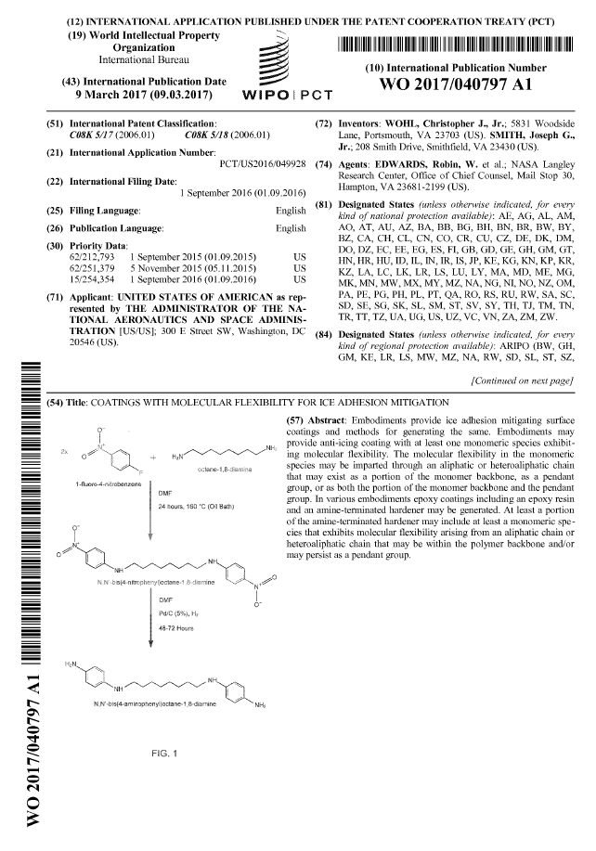
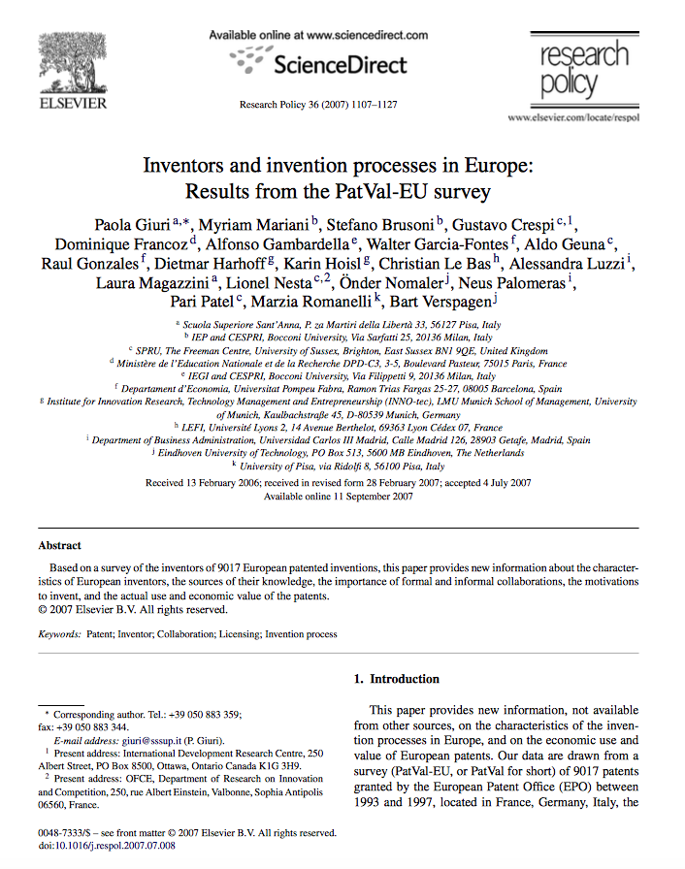
Measuring science
These have a few common advantages:
Available in structured datasets
Many variables can be used
Free text data also starts to be explored
What data can be used?
(Many of these are relevant for both patents and publications)

Slide 11
Publication data
What do the data look like?
What are the main databases?

Slide 12
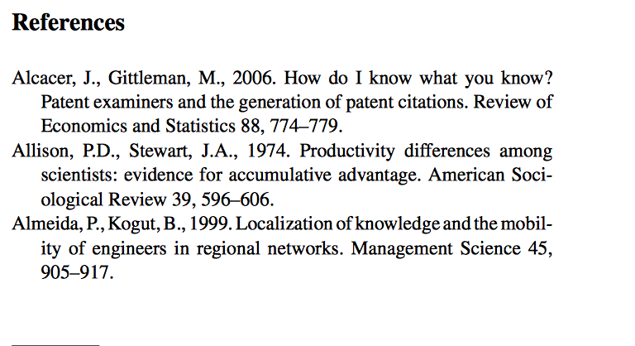
Measuring science
What data can be used (e.g. bibliometric metadata)?
Metadata give information about other data (i.e. scientific papers or patents)
Title of the paper
Abstract
Authors
Author addresses
Journal
Author keywords
References

Slide 13
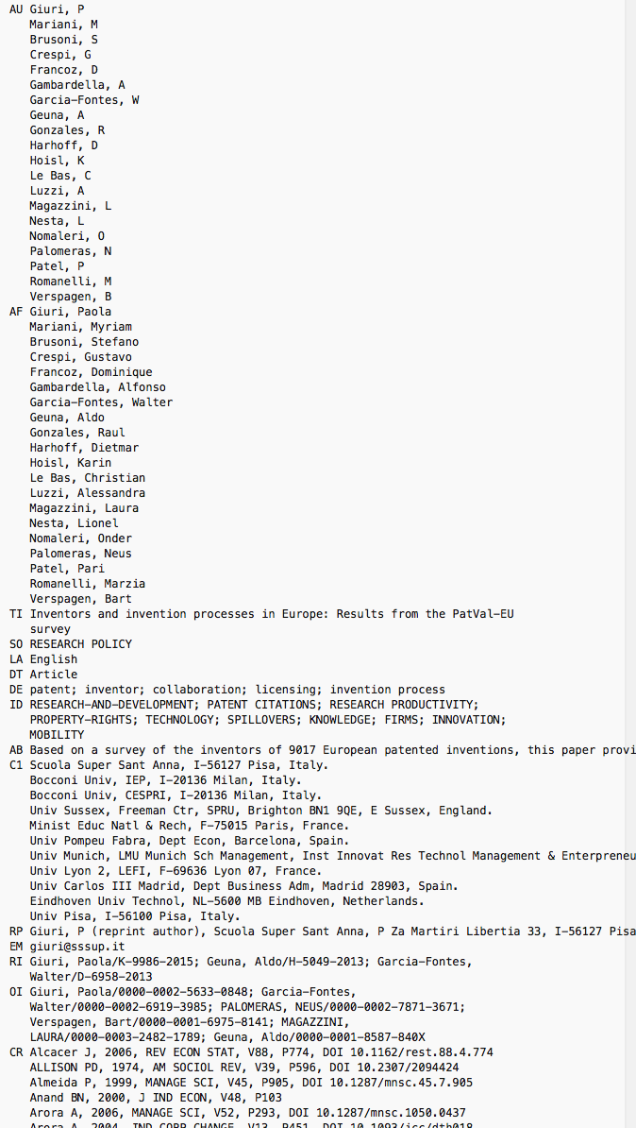
Measuring science
What data can be found in datasets?
Example Web of Science
AU: Authors
AF: Authors’ full name
TI: Title
SO: Source (journal name)
DT: Document type
DE: Authors’ keywords
ID: keywords assign by WoS algorithms
AB: Abstract
C1: Authors’ affiliations
TC: Total citations
PY: Publication year
DI: DOI
SC: Subject categories (put in place by WoS)
🡪 How are these datasets made?

Slide 14
Bibliometric datasets
What do the data look like?
What are the main databases?

Slide 15
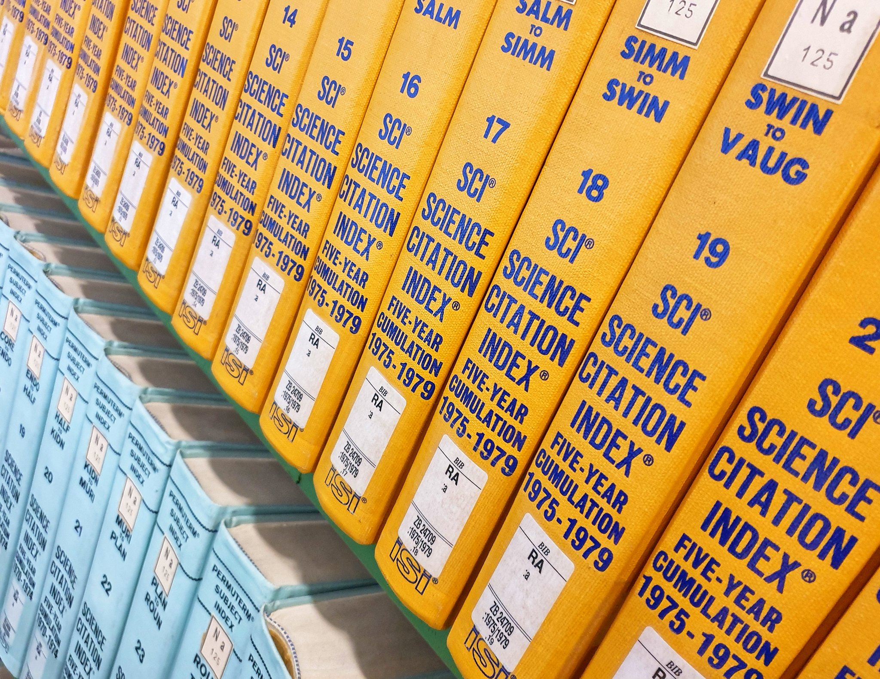
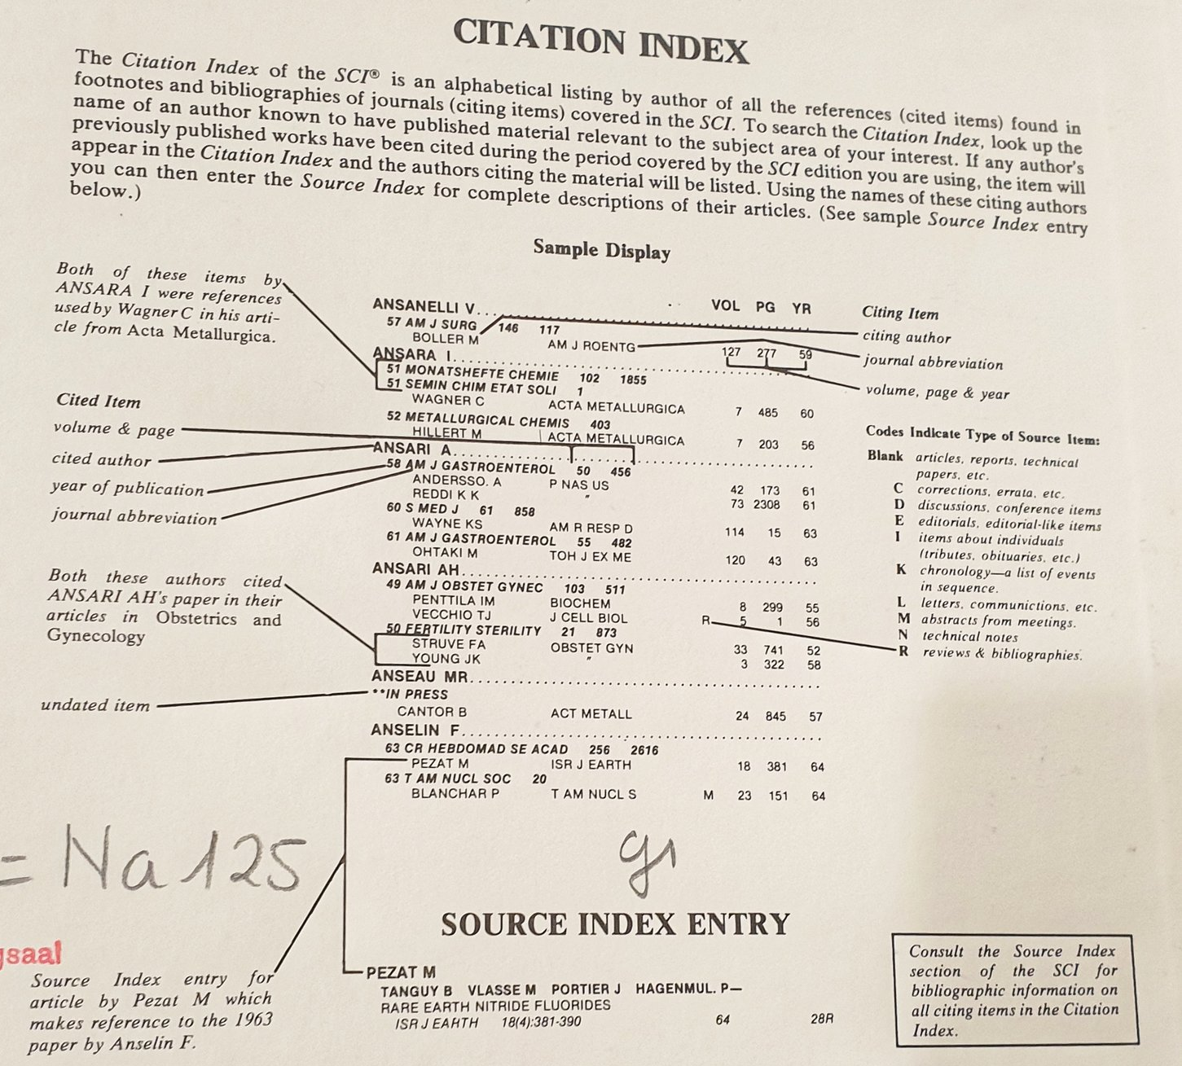
Bibliometric databases
Many databases used for bibliometric research today come from Indexing systems
These databases of scientific publications include metadata about scientific articles
Historically linked individual publications to references.
In the 1960s these were disciplinary at first
The first interdisciplinary one was the Science Citation Index.

Slide 16







Bibliometric databases
The ISI was subsequently bought by Thomson Reuters and then by Clarivate analytics – and called now the Web of Science.
There are also new companies providing databases about scientific publications and citations (among others: Scopus, Dimensions, or even google scholar)

Slide 17
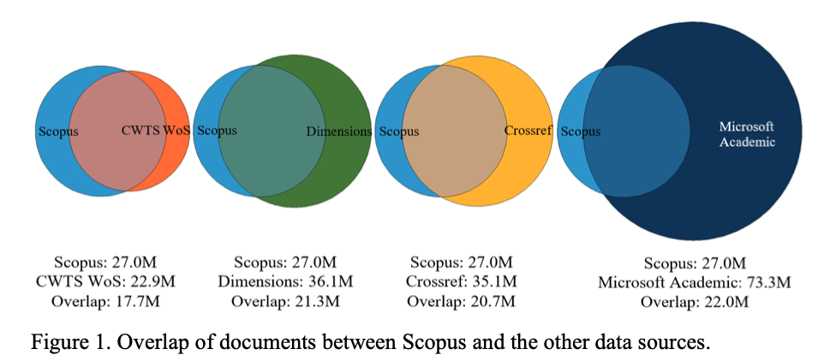
Bibliometric databases
Comparison of articles indexed in each database between 1996-2017 (Visser et al. 2019)
Bibliometric databases have may not index the same articles

Slide 18
Bibliometric databases
These datasets have grown to include more and more fields:
1) To add more data:
Add more journals over the years
Funding information have been added in the late 2000s (e.g. 2008 for the Web of Science)
2) To include a set of indicators
(Journal Impact factor, Citation count, h-index …)
There is an increasing link between datasets, so publications in one dataset can be matched in others. This is done through unique identifiers such as the doi (digital object identifier), WOS id, Pubmed id are available in a range of dataset so you can combine fields from specific datasets.
Other Ids are now introduced: author id (ORCID classification), discussion of grant id etc.

Slide 19
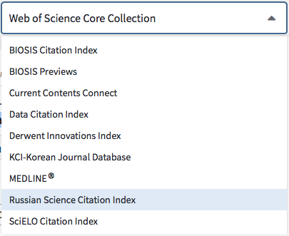
Bibliometric databases
How do I choose the right dataset?
Check the coverage:
Language (WoS / Scopus ... for English literature)
Disciplines (WoS for Science, Scopus for Social Sciences, Pubmed for medical Sciences, CAB for agriculture).
Classification:
Pubmed (expert classification)
WoS categories
Meta-data:
Authors (WoS, Scopus)
Citations (WoS, then scopus)
- Free to use? (Dimensions, Microsoft academic).

Slide 20
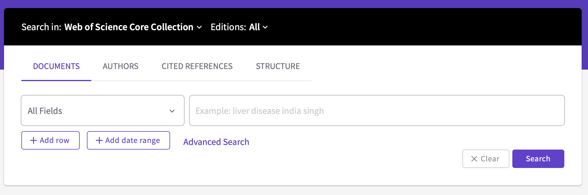
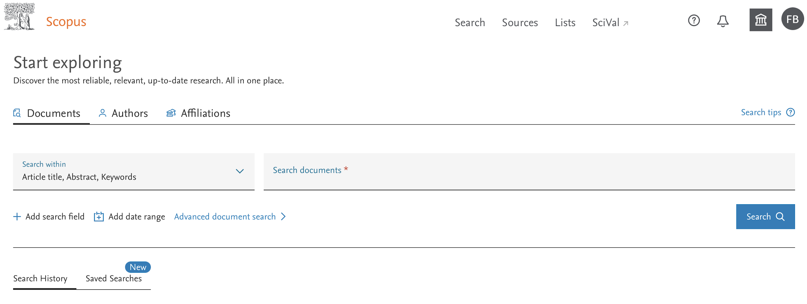
Bibliometric databases
How to search for publication data:
Notes:
https://www.lens.org

Slide 21
What indicators can we use?

Slide 22
First to understand how science works…

Slide 23
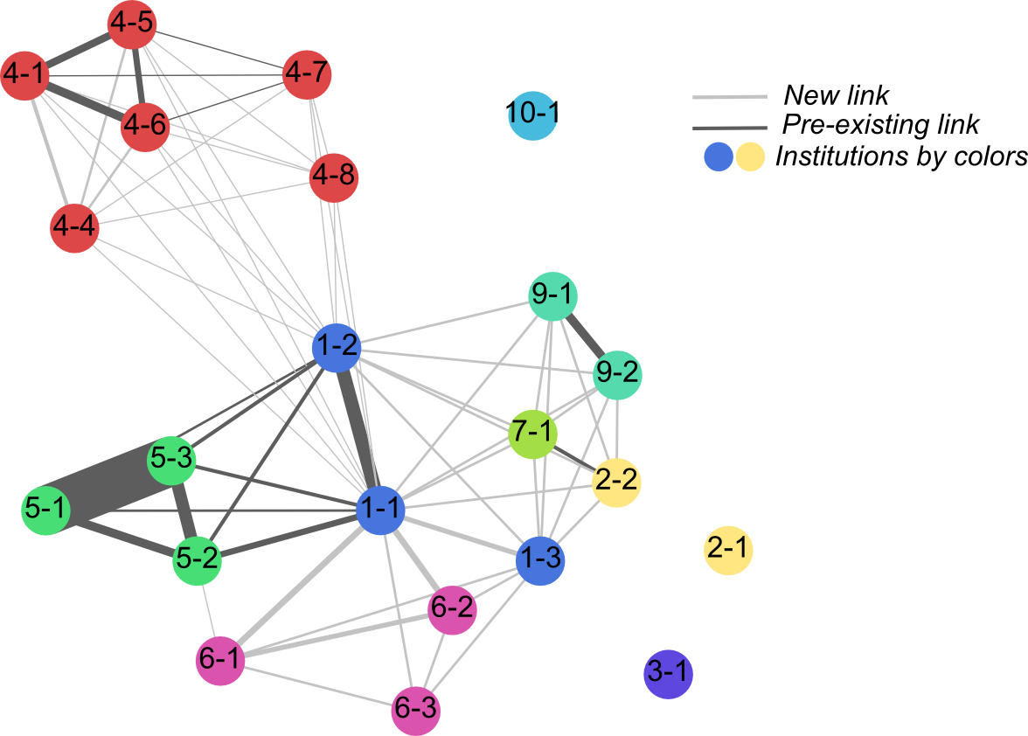
Scientometric indicators
Using publications to understand research collaborations:
Use authorship, addresses to understand how individuals, organisations, cities, countries are linked.
Looking at networks of collaborators for a technology, within a field, etc.
Co-publication network working on
a tropical neglected disease.

Slide 24



Scientometric indicators
Using publications to understand research collaborations:
Use authorship, addresses to understand how individuals, organisations, cities, countries are linked.
Looking at networks of collaborators for a technology, within a field, etc.
Detecting relationships, implies that all entities are reported in a consistent manner:
Authors name (e.g. A. Smith, M. Hopkins)
Affiliation: some department are part of two
organisations (e.g. university, CNRS)
Addresses: part of addresses are reported
🡪 Think about disambiguating names (see side for tools)

Slide 25
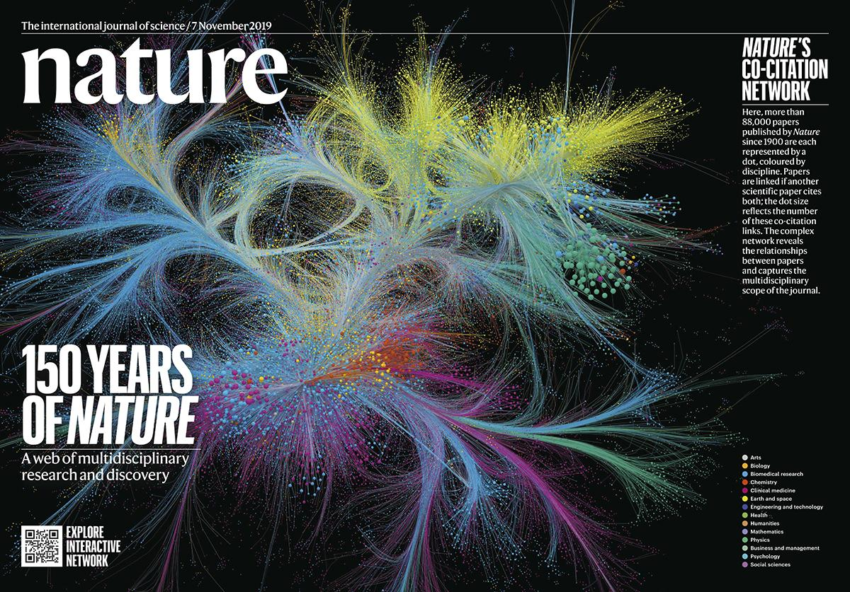
Scientometric indicators
What can I use citations for?

Slide 26
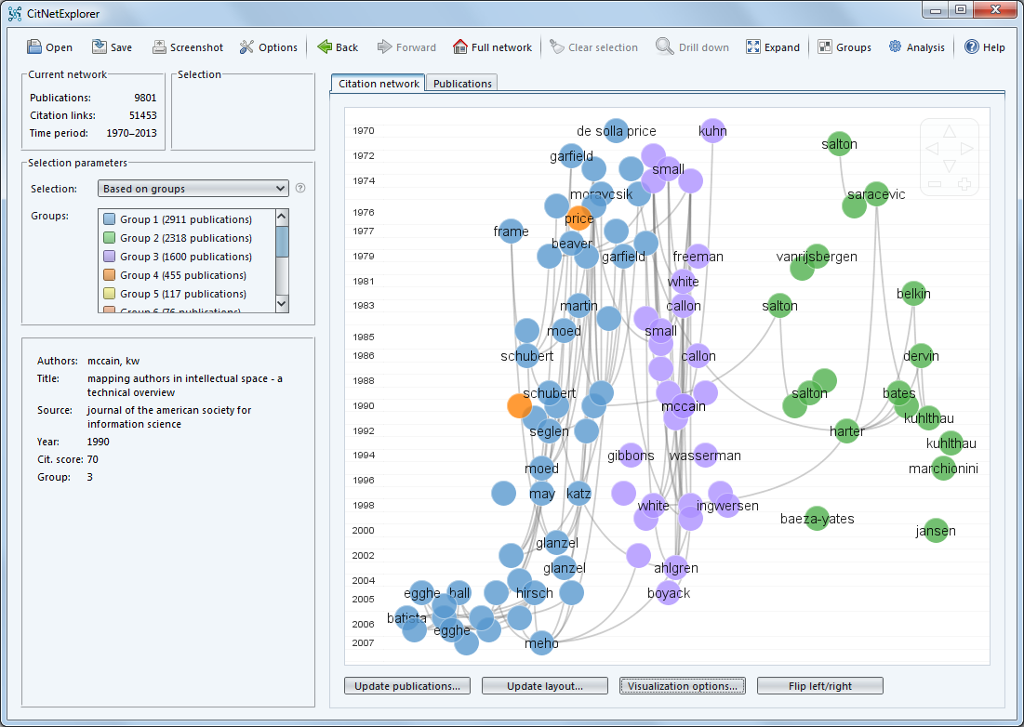
Scientometric indicators
Direct citation analysis:
Looking how a paper/journal/discipline build on previous knowledge
Looking how a paper/journal/discipline is important to future knowledge

Slide 27
Scientometric indicators
Direct citation analysis:
Looking how a paper/journal/discipline build on previous knowledge
Looking how a paper/journal/discipline is important to future knowledge
Relatedness of papers:
Co-citation analysis (Small, 1973; Marshakova 1973)
Co-citation
C
D
E
F
A
B
The more articles are citing the same two works, the more these documents are related.

Slide 28
Scientometric indicators
Direct citation analysis:
Looking how a paper/journal/discipline build on previous knowledge
Looking how a paper/journal/discipline is important to future knowledge
Relatedness of papers:
Co-citation analysis (Small, 1973; Marshakova 1973)
Bibliographic coupling (Kessler 1963)
Bibliographic coupling
A
B
C
D
E
F
Infer the strength of the relationship between two documents based on how many citations they share

Slide 29
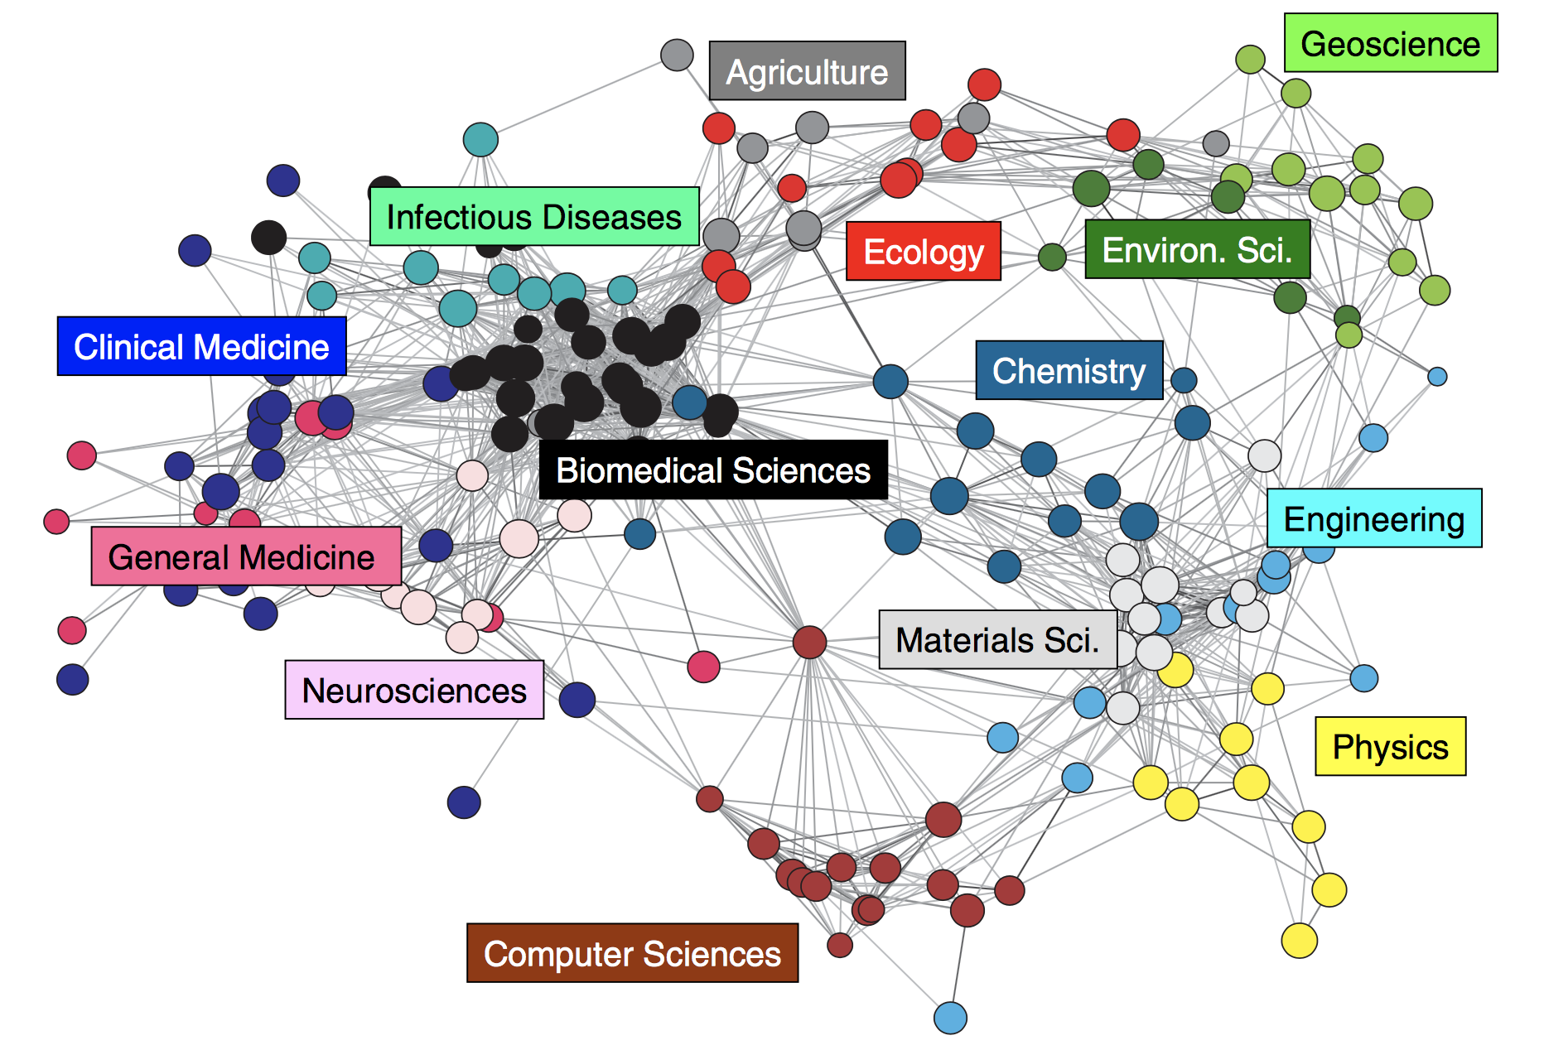
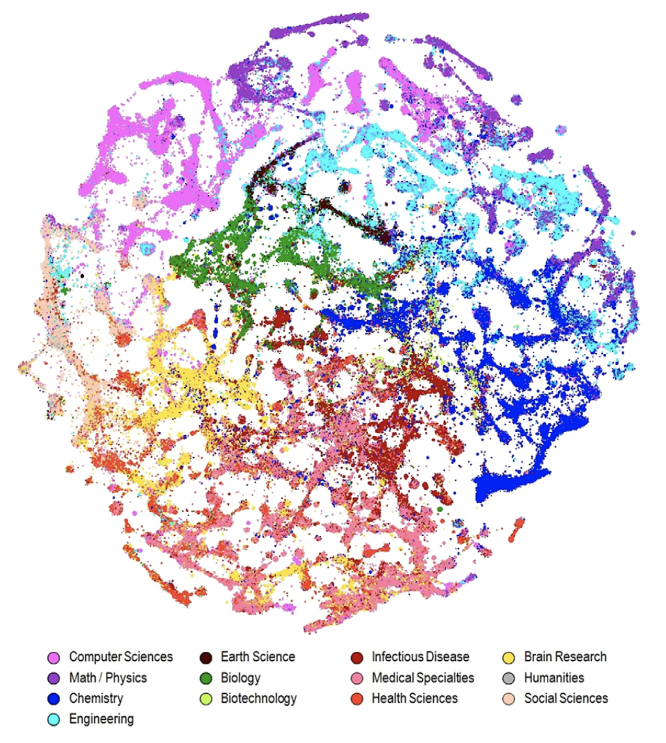
Scientometric indicators
Direct citation analysis:
Looking how a paper/journal/discipline build on previous knowledge
Looking how a paper/journal/discipline is important to future knowledge
Relatedness of papers:
Co-citation analysis (Small, 1973; Marshakova 1973)
Bibliographic coupling (Kessler 1963)
Understanding the overall structure of science:
🡪 using the above techniques to map the structure of science.
Rafols and Meyer (2009)
Boyack and Klavans (2014)

Slide 30
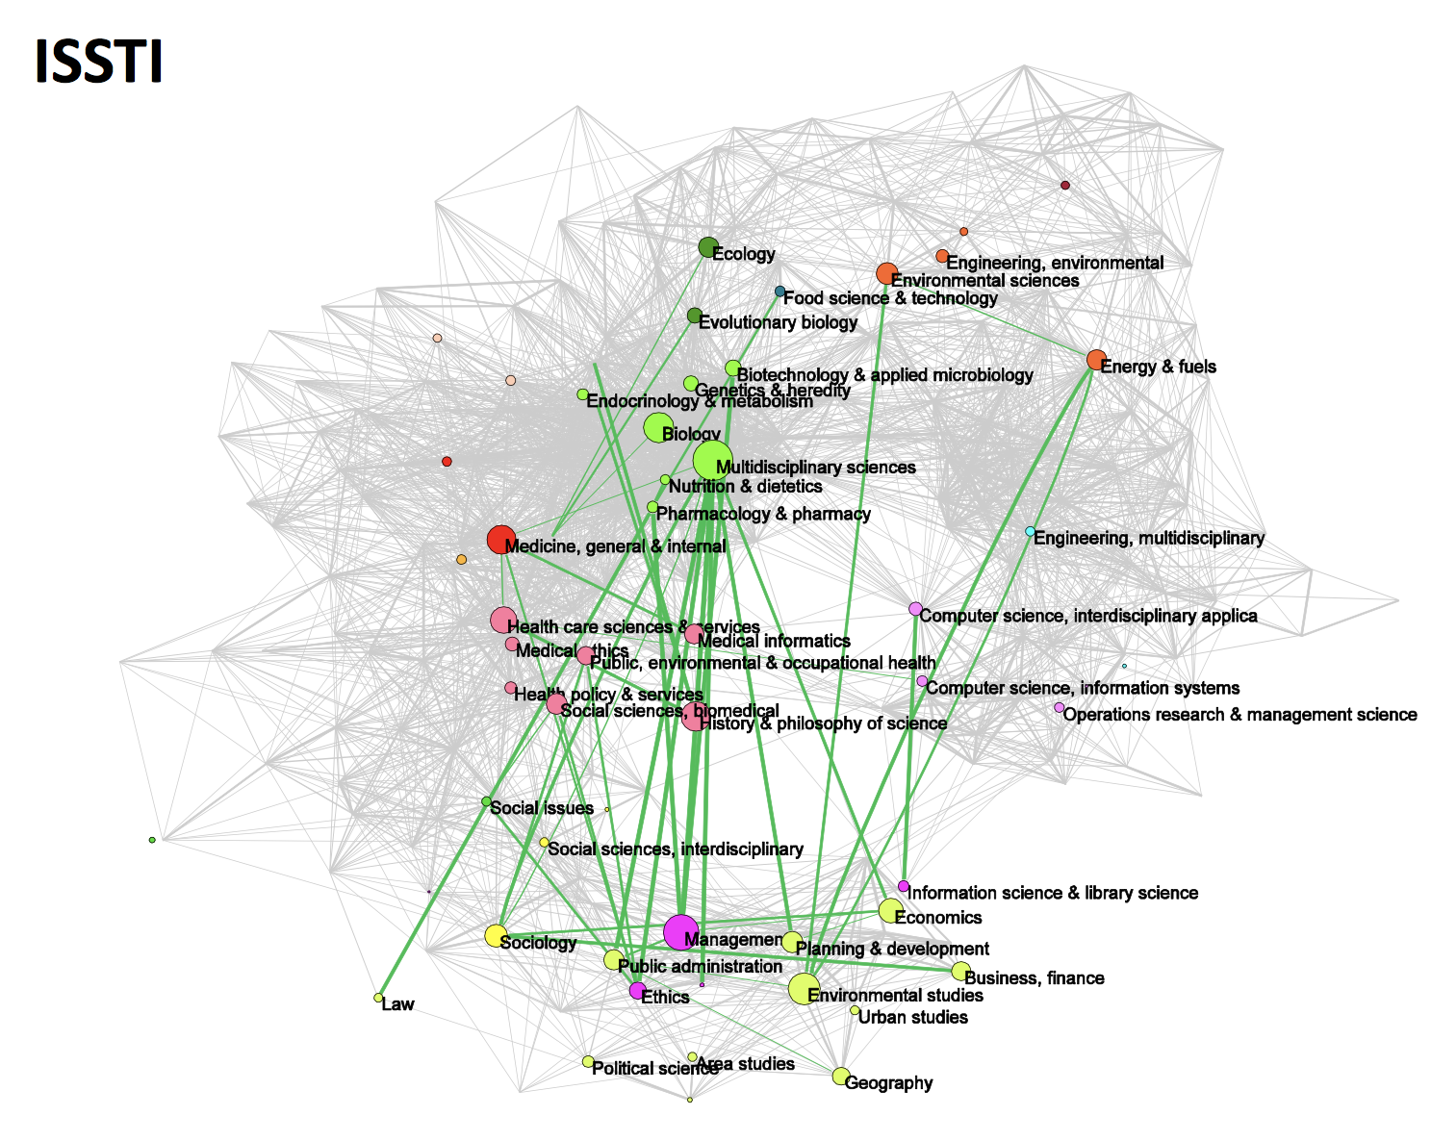
Scientometric indicators
Direct citation analysis:
Looking how a paper/journal/discipline build on previous knowledge
Looking how a paper/journal/discipline is important to future knowledge
Relatedness of papers:
Co-citation analysis (Small, 1973; Marshakova 1973)
Bibliographic coupling (Kessler 1963)
Understanding the overall structure of science:
🡪 using the above techniques to map the structure of science.
Understanding how communities work together:
(Rafols et al., 2012)
Understanding interdisciplinarity
Notes:
multid: speak as separate voices, adding juxtaposition
Inter: integrate separate approacjes
trans: transcend

Slide 31


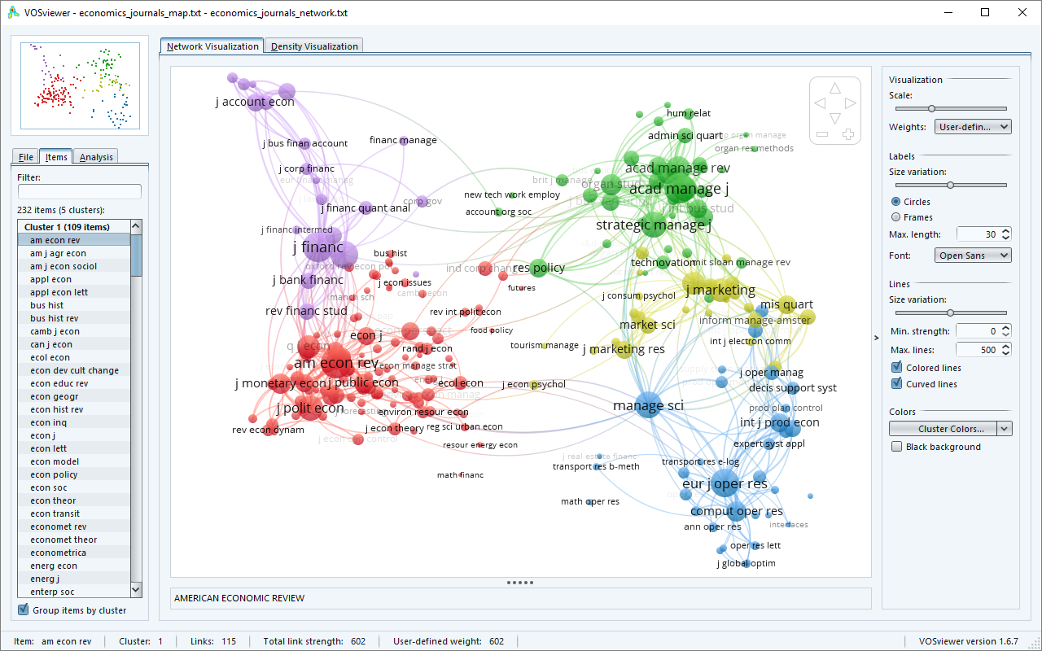
Number of tools that can help
https://www.citnetexplorer.nl/
Notes:
multid: speak as separate voices, adding juxtaposition
Inter: integrate separate approacjes
trans: transcend

Slide 32
Second to understand science’s impact…

Slide 33

Science’s impact
There are two main ways to look at impact, first looking a the productivity (output count), and second, looking at how these outputs have been received (citations count).
Research unit considered: researcher, research group, research institution, country, journal …
Productivity:
nb of publications over a period of time
In a selected set of outlets (e.g. REF)
nb of collaborators (type of collaborators may be important)
nb of patents
nb of spin-offs
nb of mentions in social media (see altmetrics)
Public engagements (dissemination of knowledge or awareness to a variety of actors / publics)

Slide 34



Altmetrics
There are new indicators in development that make use of online resources to give an indication of impact (on a shorter time scale).
“Thousands of conversations about scholarly content happen online every day. Altmetric tracks a range of sources to capture and collate this activity, helping you to monitor and report on the attention surrounding the work you care about.” (altmetric.com)
“Over the last two decades the way people use research and communicate about research has completely changed. People often learn about and find research though their social media network. They access research through a myriad of sites including open access repositories. […] In early 2012, Plum Analytics was founded with the vision of bringing modern ways of measuring research impact to individuals and organizations that use and analyze research.” (plumanalytics.com)
Altmetric coupling…?

Slide 35
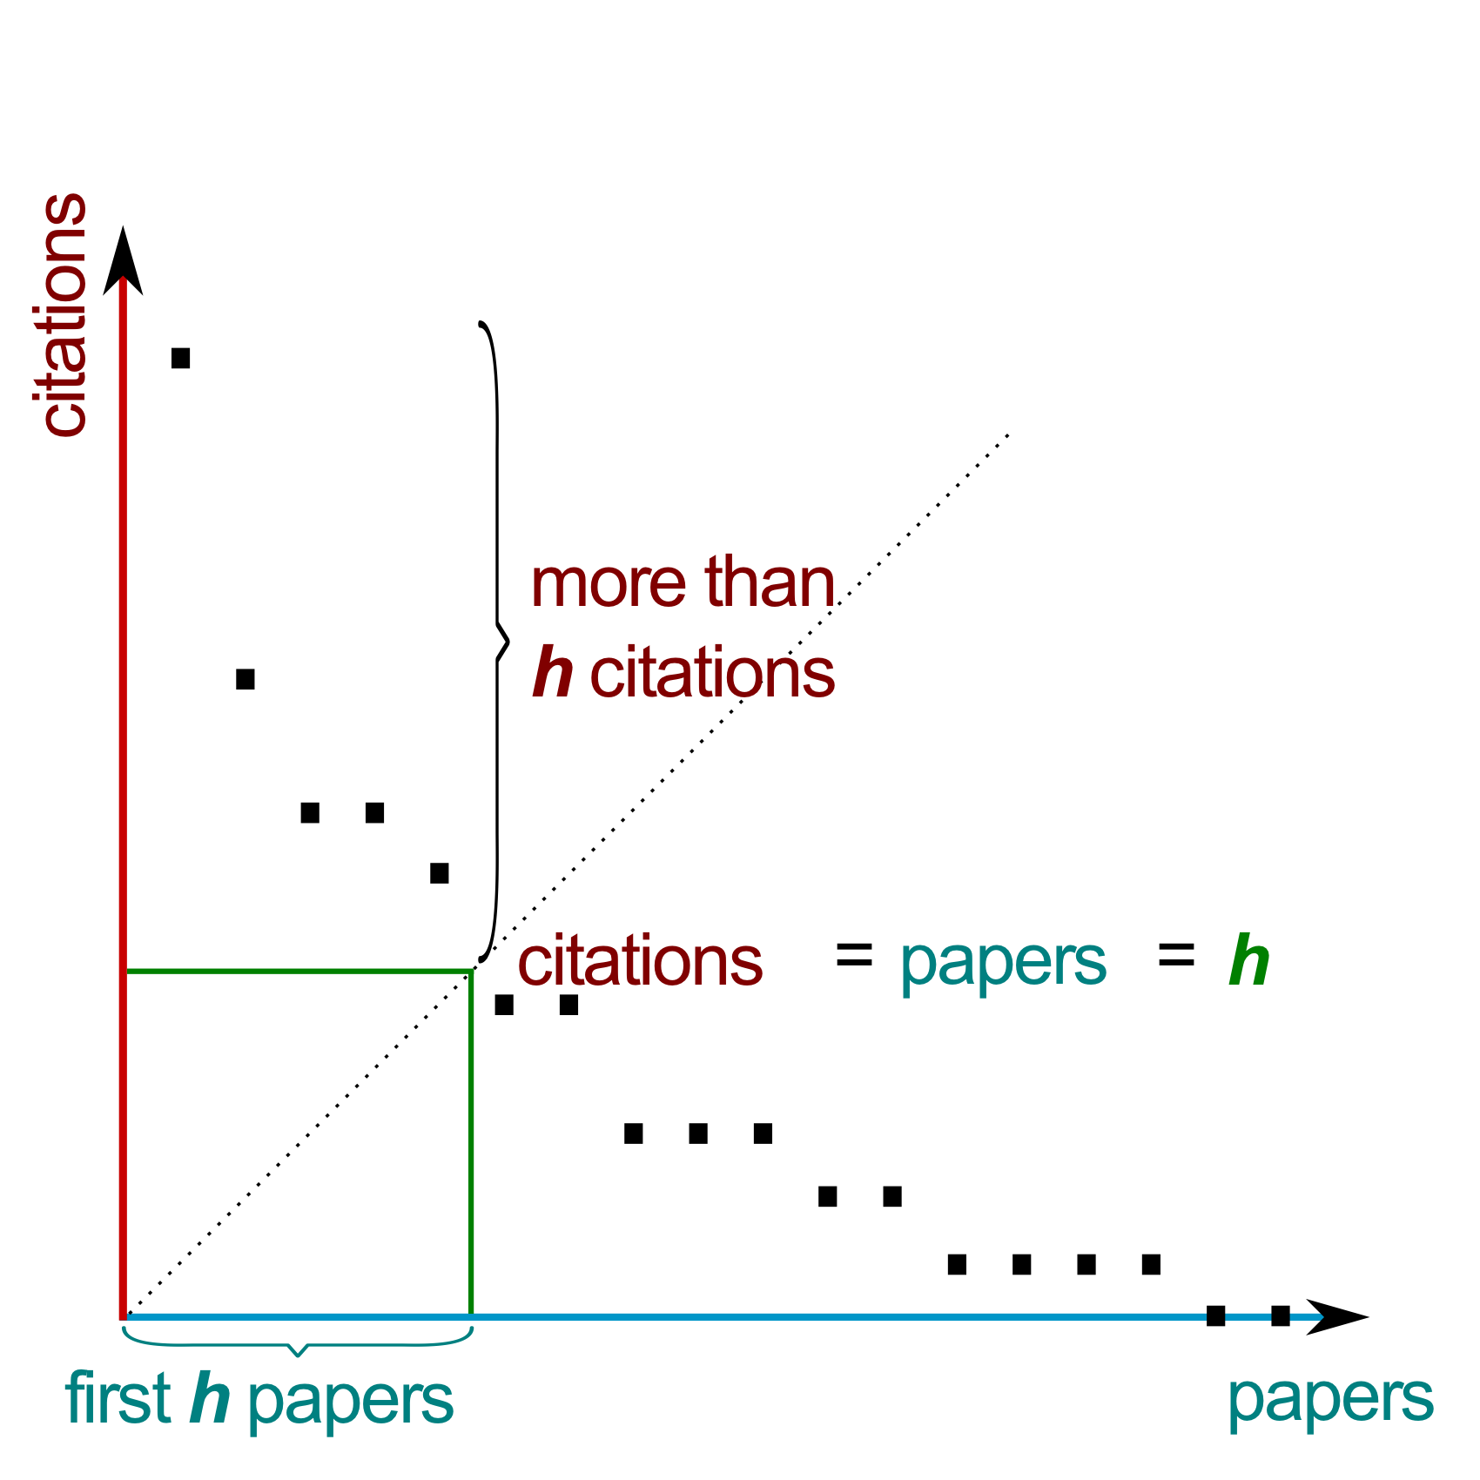
Science’s impact
There are two main ways to look at impact, first looking a the productivity (output count), and second, looking at how these outputs have been received (citations count).
Research unit considered: researcher, research group, research institution, country, journal …
Impact through citations:
Total number of citations across publications
Average number of citations per publication
Number of highly cited publication (pre-set threshold)
Proportion of highly cited publication (pre-set threshold)
h-index (see side)
Journal Impact factor: A journal’s impact factor is based on
2 elements: the numerator, which is the number of citations
in the current year to items published in the previous 2 years,
and the denominator, which is the number of ‘citable items’
published in the same 2 years. (Garfield, 2006)
Notes:
citable tiems

Slide 36
Comparability
The production of numbers using a unique recipe can give a sense that these indicators are a basis for comparison between research units. However different fields of study have different characteristics and should not directly be compared (Waltman, 2016).
Counting collaborators on publications:
Depending on type of projects (e.g. megaprojects in particle physics)
Increasing nb of authors per publications
Should we allocate full impact to publications to all authors (i.e. full counting)?
Alternative counting methods:
fractional counting: each author get a equal share of the credit
institution or country sum the share of contributions of their researchers
Weighted credits: position in author list, corresponding author…
🡪 The ordering of authorship vary by field, and their meaning is debated.

Slide 37
Comparability
The production of numbers using a unique recipe can give a sense that these indicators are a basis for comparison between research units. However different fields of study have different characteristics and should not directly be compared (Waltman, 2016).
The citation have different patterns depending on :
Fields / discipline of study
Years of publications
Document types (reviews, editorial, letters, articles)
The citation score can be normalised on:
average citation count
determine whether a publication can be considered as highly cited within field (e.g. top 1%, 10%)
Others exist…
🡪 Need to consider the classification system at hand to delimit the boundary of a field.

Slide 38
Patent data
What do the data look like?
What are the main databases?

Slide 39
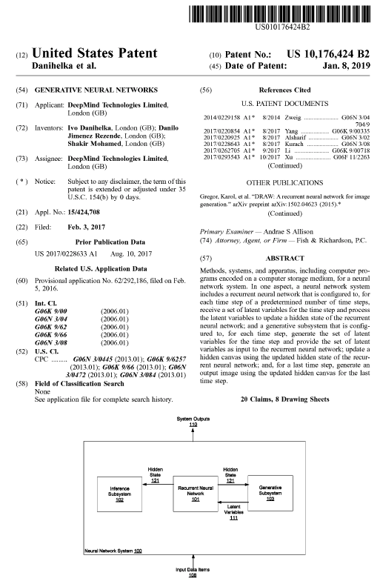
Measuring science
What patent data can be used (e.g. bibliometric metadata)?
Title
Applicant(s)
Inventor(s)
Assignee
Publication date
Filling date
Priority date
Classification
Patent references
Other references
Abstract
Claims

Slide 40
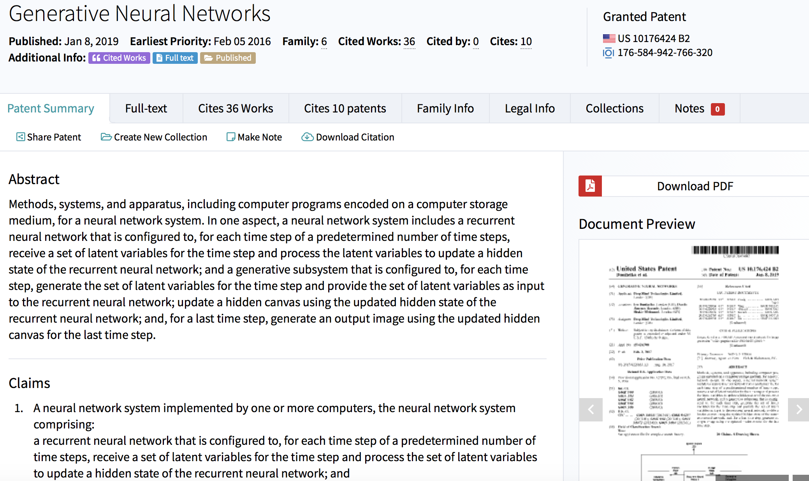
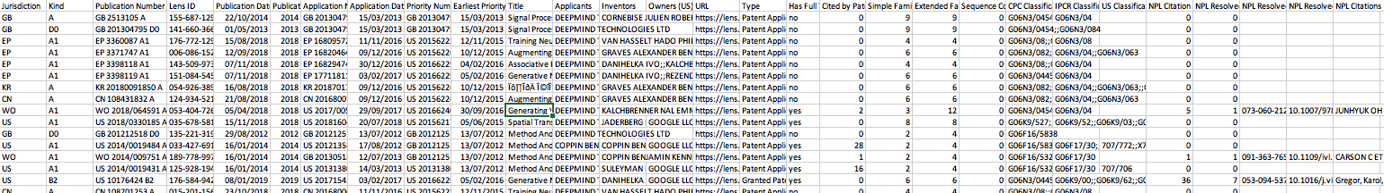
Patent data
What data can be found in datasets?
Example PatentLens
Jurisdiction: Country where the patent is filed
Kind: Classification
Publication number
Lens ID
Publication Date
Applicants
Inventors
…
🡪 What are the main patent datasets?

Slide 41







Patent databases
There is a mix of datasets which enable to search for patents, they vary in access, coverage of regions and time.
There is a mix of free and paying services, the ones shown here are mainly free, but all are accessible to you.
They vary in terms of the search that they offer, data fields provided.. check documentation on individual websites.
Notes:
WIPO: World Intellectual Property organisation

Slide 42
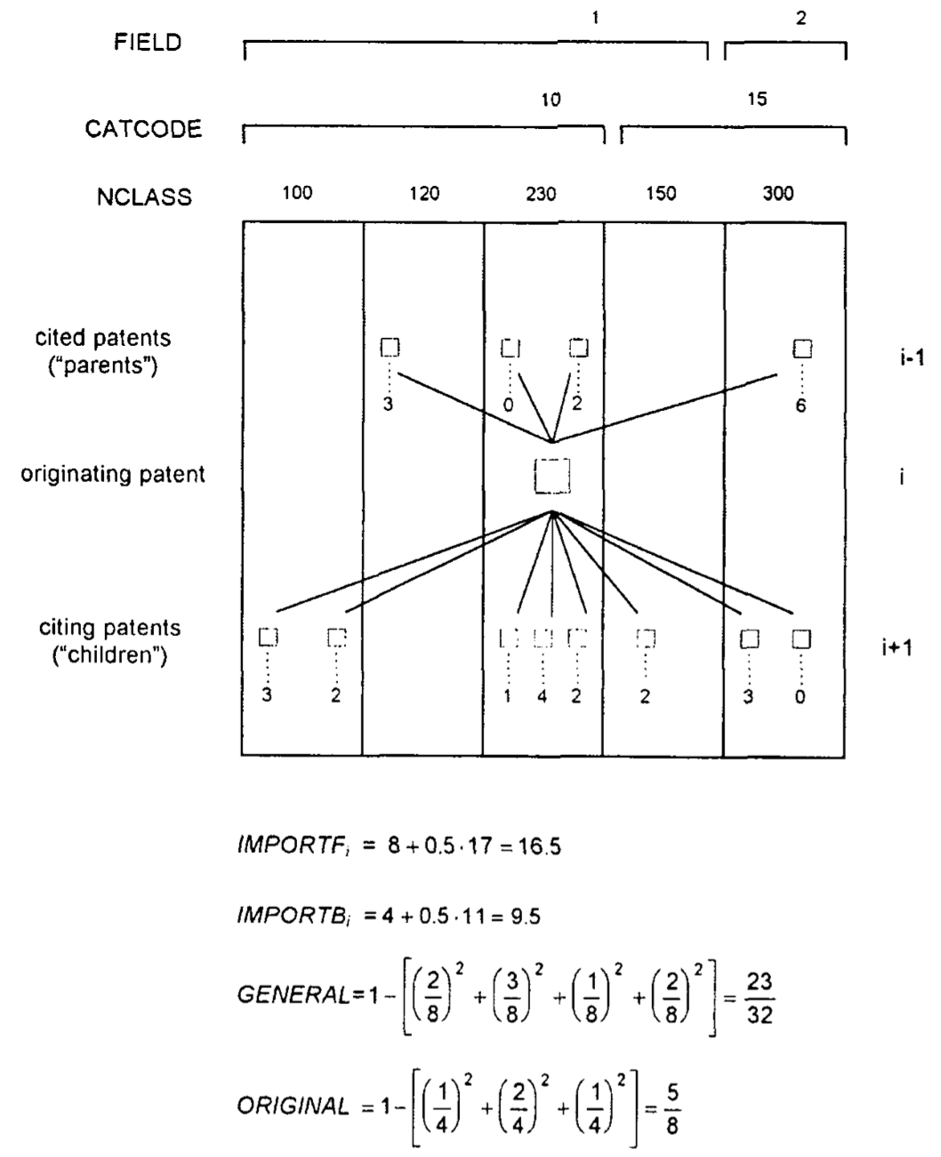
Technology’s impact
Like publications, patents have also two main way to look at their impact, looking at patent count, and patent citations.
Trajtenberg (1990)
Simple Patent counts
Weighted by citations count (to adjust for the value of an innovation)
Trajtenberg et al. (1997)
Patent generality (see side)
Patent originality (see side)
Patent radicalness: where a patent is dissimilar in citation structures of past patents and concurrent patents, and citation structure will be replicated in the future. (Dahlin, 2005)
Notes:
1+nb of coitation
of weighted patent counts (WPC) for, say, a given product class in a given year, t, I would have,
nt
WPCt=:(1+CO),(1) i=1
where nt is the number of patents issued during year t in that product class. This linear weighting scheme then assigns a value of one to all citations and all patents. Lacking more information on the citation process, this is a natural starting point but certainly not the only possibility; in fact, in Section 5, I compute a nonlinear index that allows for the existence of "returns to scale" in the informational content of citations.

Slide 43
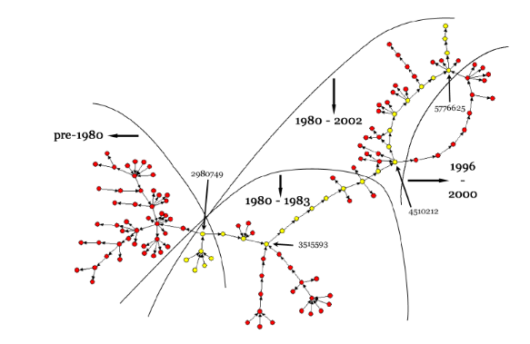
Technology’s trajectory
Understanding how technologies evolve by Verspagen (2006):
Looking at one specific patent class ‘Fuel cells’
Using citation network
Using main path analysis
Notes:
1+nb of coitation

Slide 44
What do the data, and indicators represent?

Slide 45
Publication data
A publication is a piece of research, which aims at communicating to peers results of the research. It has to show that it is relevant to a field, and a specific journal it is published in.
This has an impact on the main contribution and on the references.

Slide 46
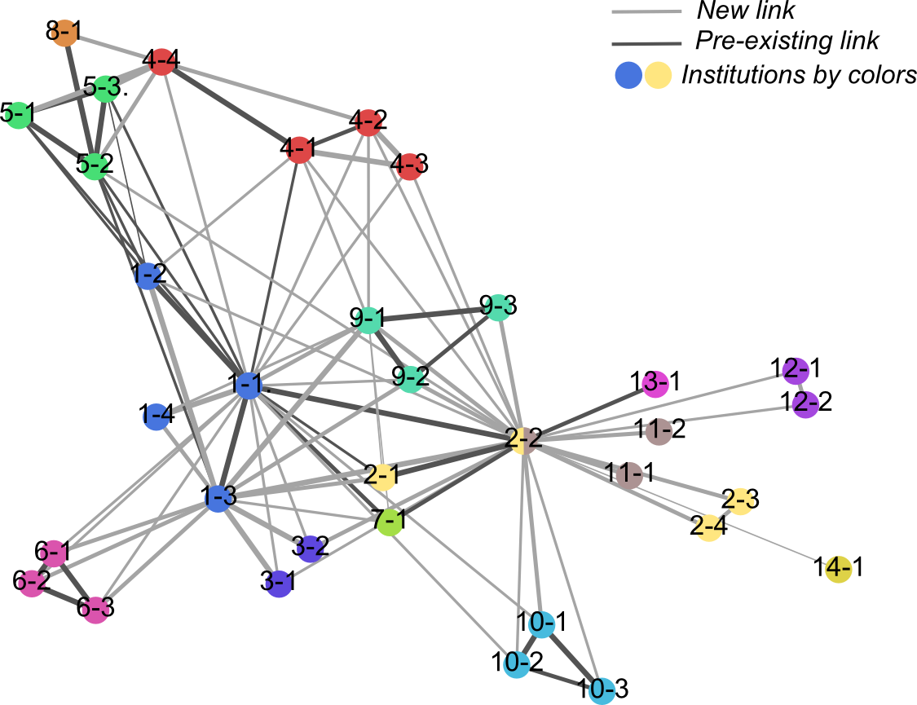
Publication data
A publication is a piece of research, which aims at communicating to peers results of the research. It has to show that it is relevant to a field, and a specific journal it is published in.
This has an impact on the main contribution and on the references.
Other considerations:
Is co-publication a good proxy for collaborations? (e.g. study of neglected disease)
Time lag between doing the research, submitting the paper and publication

Slide 47
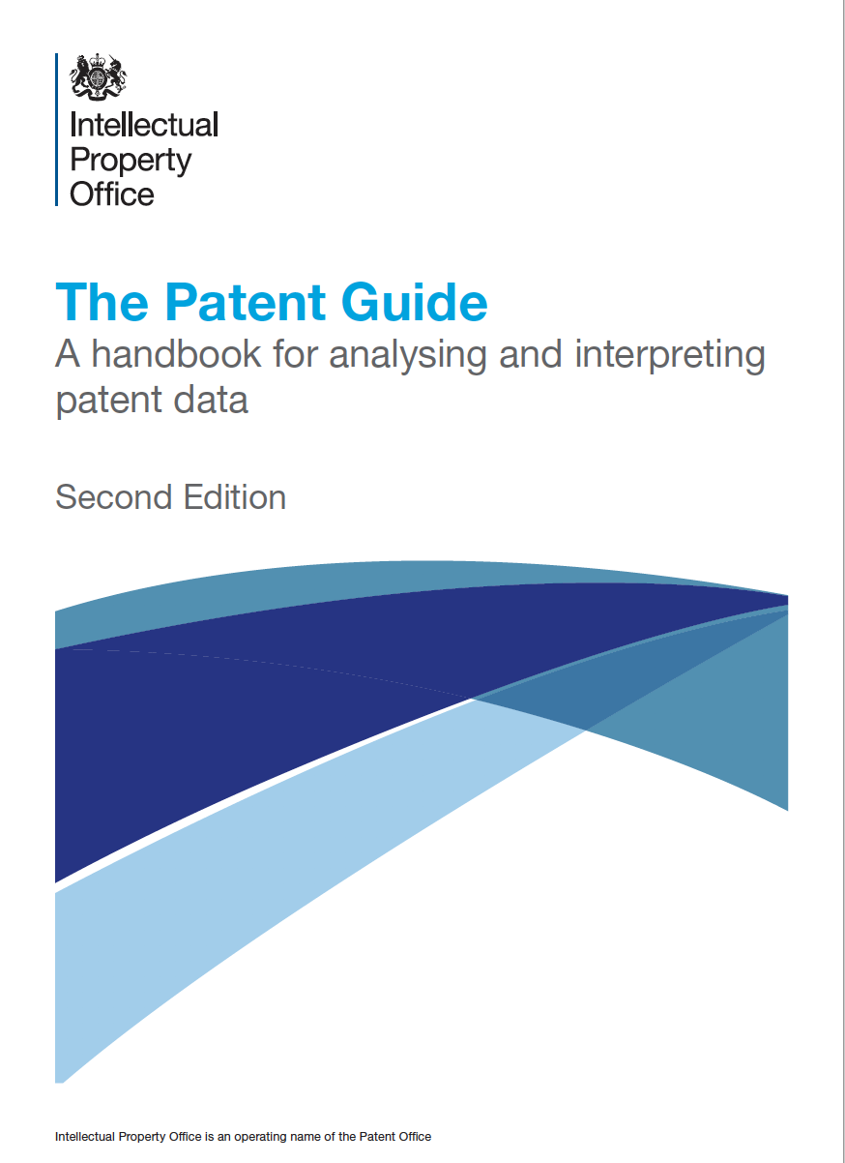

Patent data
https://assets.publishing.service.gov.uk/government/uploads/system/uploads/attachment_data/file/463319/The_Patents_Guide_2nd_edition.pdf
Patent has two main functions:
to protect: exclusion of exploiting commercially an invention in a given country or region) up to 20 years.
to disclose: patent application give public access to information about new technologies.
It contains both legal information and technical information…
Considerations on looking at patents:
Time given on patents from patent filing, priority to granted date. There can be considerable time lag between these.
Citation as knowledge flow: many citations can come from examiners and not applicants (depends also on the country of application).
https://www.wipo.int/edocs/pubdocs/en/wipo_pub_l434_3.pdf

Slide 48
Using indicators for evaluation:
The two sides of the coin.

Slide 49
Accountability and behaviour
Accountability metrics and behaviour:
Once a metric is used to assess the performance it may affect the behaviour of the one assessed (individuals and organisations).
Changes can occur in terms of (Wouters, 2014; the metrics tide):
Goal displacement: high-score in the given measure becomes an end rather than a means.
Higher quantity of publications (salami slicing)
Selection of journals to publish in (high impact factor)

Slide 50
Accountability and behaviour
Accountability metrics and behaviour:
Once a metric is used to assess the performance it may affect the behaviour of the one assessed (individuals and organisations).
Changes can occur in terms of (Wouters, 2014, the metrics tide):
Profound changes in the research process itself
Financial rewards for publications in high impact journals
Push to a focus on publications from universities
Abandonment of particular type of work (book reviews, encyclopaedia articles for historians)
Reduction of interdisciplinary work
Transfer market for research with publications in highly ranked journals
Citation clubs

Slide 51
Accountability and behaviour
Accountability metrics and behaviour:
Once a metric is used to assess the performance it may affect the behaviour of the one assessed (individuals and organisations).
Changes can occur in terms of (Wouters, 2014, the metrics tide):
Journals can also pervert their performance:
Coercive self-citation for journals to increase their impact factor (Faber Frandsen, 2007)

Slide 52
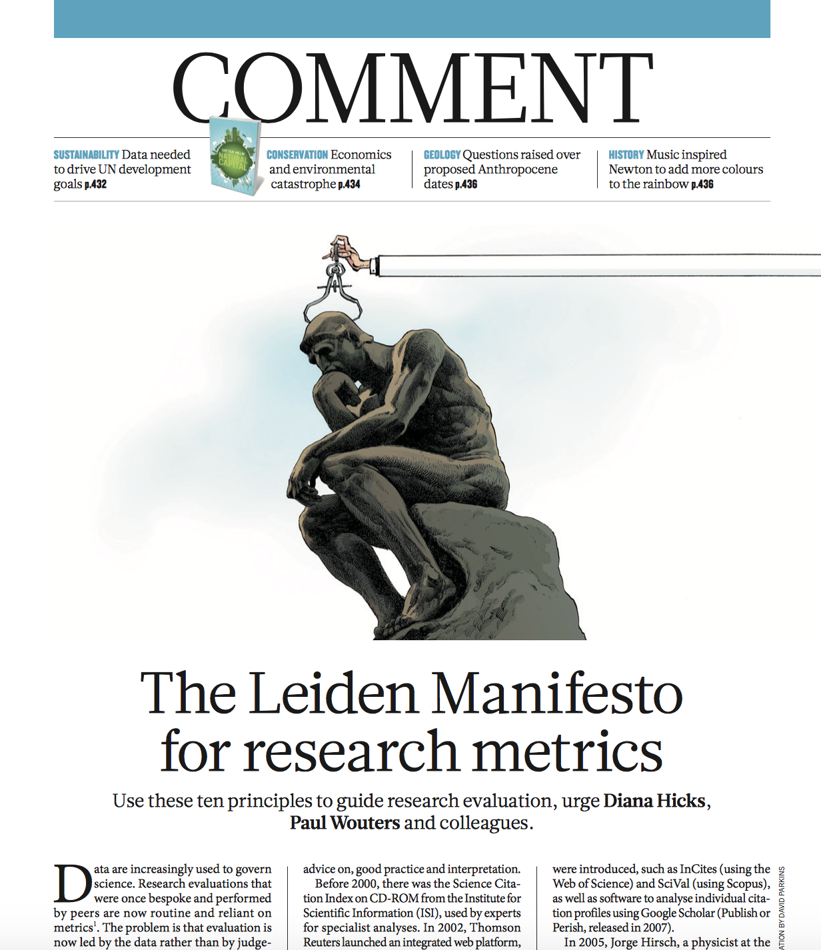
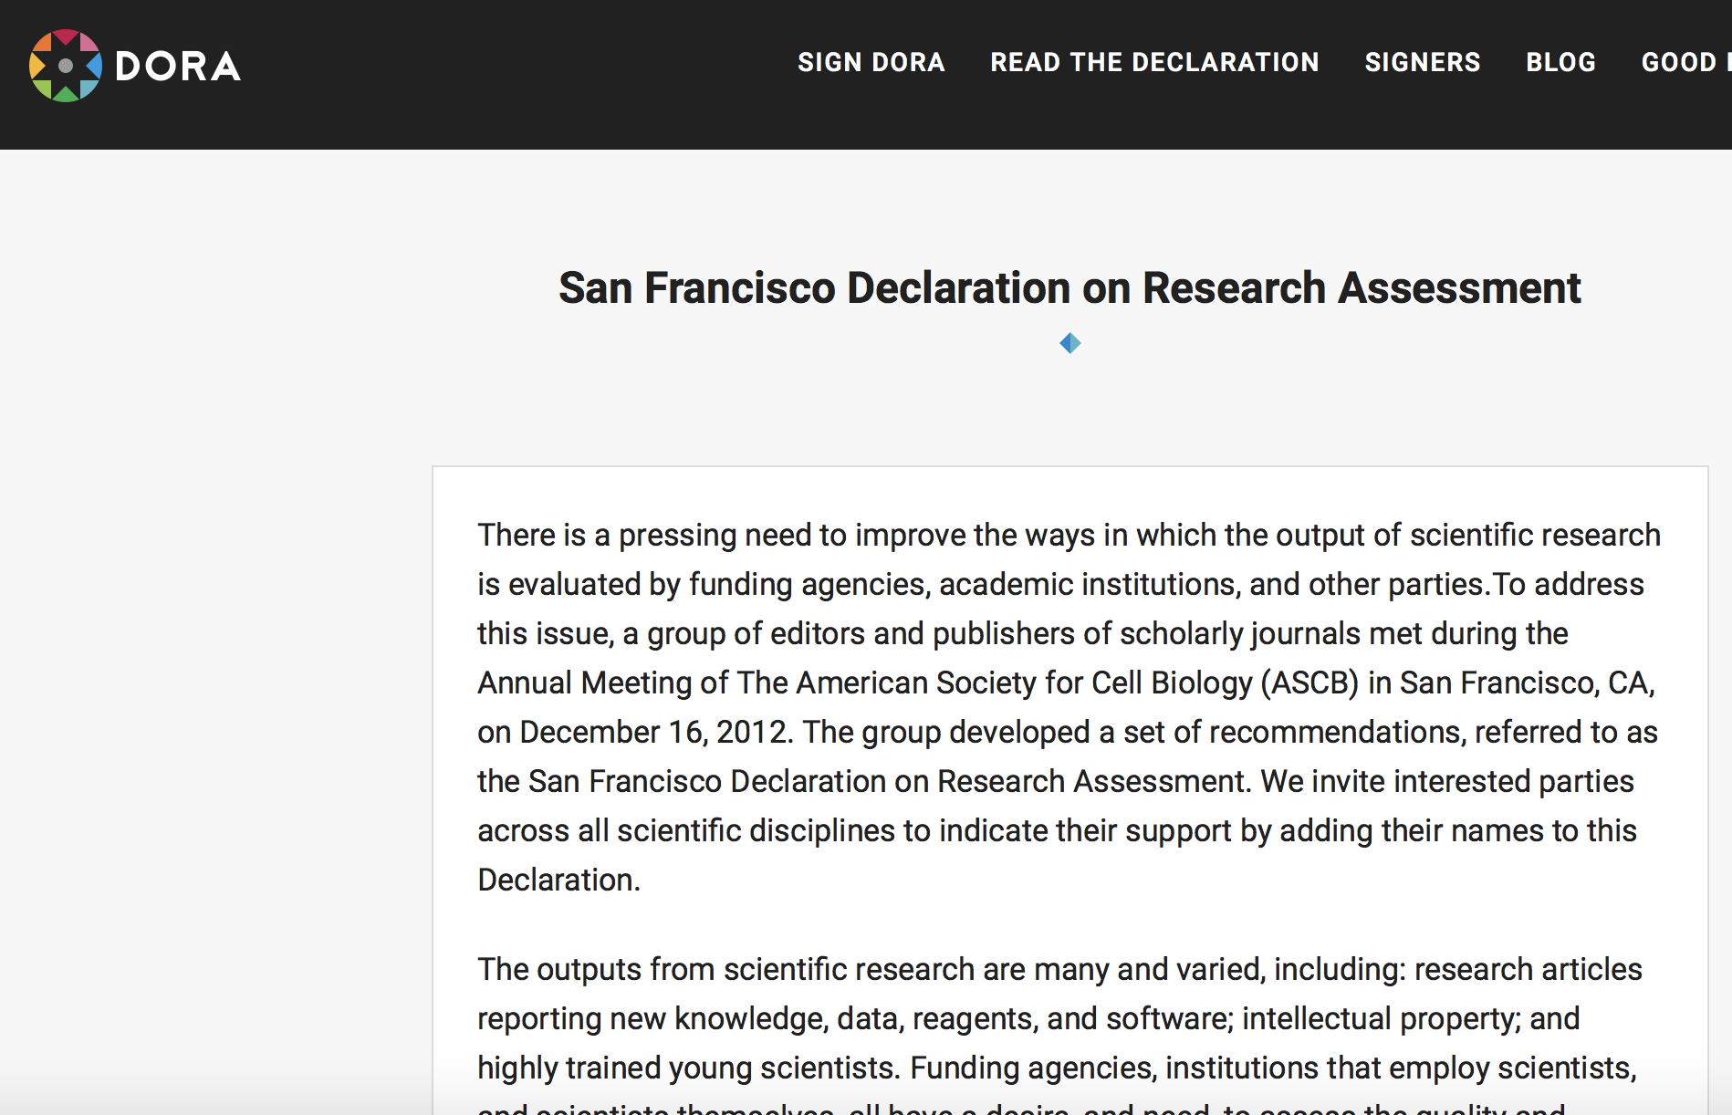
Limitations of the use of metrics
The call of the bibliometric community for a more responsible use of indicators!

Slide 53
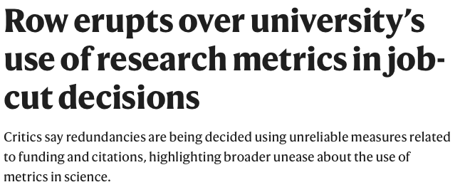
Limitations of the use of metrics
A call for an appropriate use of indicators:
Assessment of researcher’s performance:
PhD students and early career researcher are pushed to publish in high impact journals (JIF)
They are pushed to acquire external funding before they are ready
Problem of use of these indicators for funding attribution, promotion, hiring….
Nature. News. 25 March 2021
Quantitative metrics should not be used independently of qualitative or expert assessments. Research need to be judged on its own merit and not from the journal it is published in.
Measure performance against missions.
Recognise locally relevant research
Be transparent on methodology used for any assessment …

Slide 54
Let’s Practice!

Slide 55
Agenda and Learning Objectives
Let’s focus on the main sources:
Science
The use of scientific publications to study Science.
Technology and Innovation
The use of patents to study technology as artefacts.
By the end of today you will be able to understand and apply:
Science
How scientific publications can be used to study Science.
Technology and Innovation
How patents can be used to study technology as artefacts.
As well as the pros and cons of such approaches

Slide 56
Thank you. Contact:
David Eggleton
(d.eggleton@sussex.ac.uk)
Yongyuan HUANG
(Yongyuan.Huang@sussex.ac.uk)

